Slide 1
Reinforcement Learning
Q-Learning
Instructor:
Dr Yasser Alginahi
Provided by:
Somaiyeh Vaziri
Atefeh Hafezizadeh
November 2023
University of Windsor

Slide 2
Introduction
Reinforcement Learning
Q-Learning
CONTENTS
Exploration vs. Exploitation
Sample code
Applications
Summary
References

Slide 3
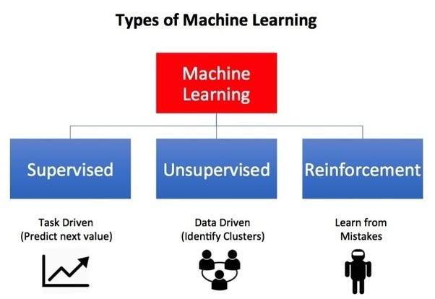
Introduction
[Source: https://tinyurl.com/mry75nzb]
3

Slide 4
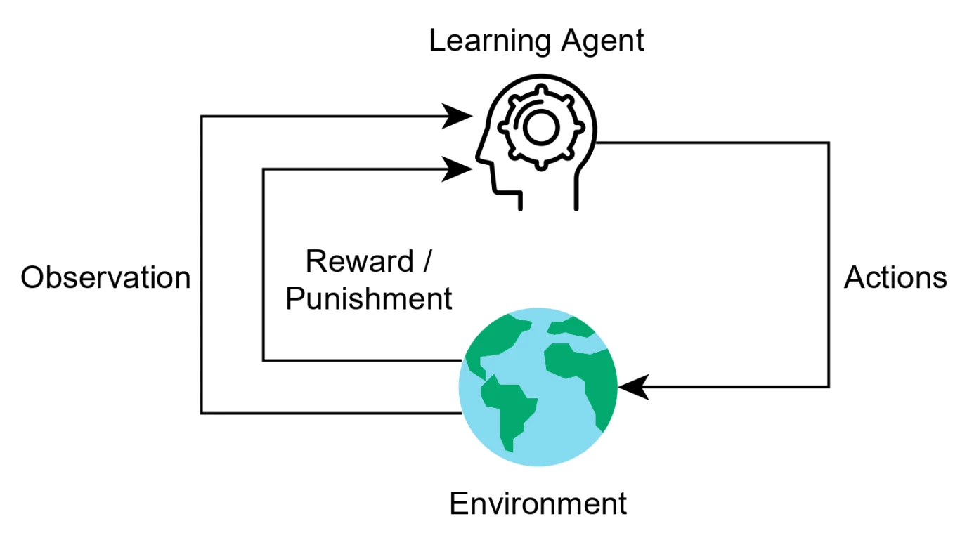
Reinforcement Learning
RL is a type of machine learning technique that enables an agent to learn in an interactive environment by trial and error using feedback from its own actions and experiences.
Percepts received by an agent should be used not only for acting, but also for improving the agent’s ability to behave optimally in the future to achieve the goal.
[Source: https://tinyurl.com/5n795dt9]
4

Slide 5
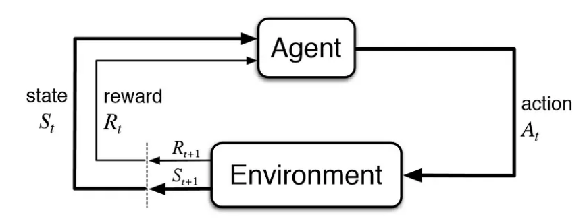
The action-reward feedback loop of a generic RL model
Reinforcement Learning:
[Source: https://tinyurl.com/mry75nzb]
5

Slide 6
A clear example of RL
Reinforcement Learning:
[Source: https://tinyurl.com/mry75nzb]
6

Slide 7
Reinforcement learning categories
Reinforcement Learning:
RL
Model-based
Model-free
Value-based
Policy-based
7

Slide 8
Q-Learning
The “Q” stands for quality
Q-learning is an algorithm that will find the best series of actions based on the agent's current state
Quality of each state represents how valuable the action is in maximizing future rewards

Slide 9
Q-Learning:
Q Learning
Model Free
Off policy
Value Based
Q-Learning categories

Slide 10
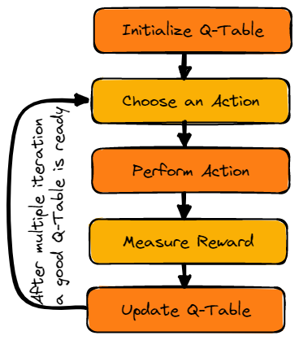
Q-learning algorithm
Q-Learning:
[Source: https://tinyurl.com/bdcd2mxt]
10

Slide 11
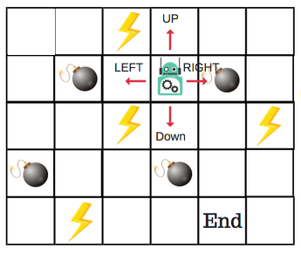
Key Terminologies in Q-learning
Q-Learning:
States(s): the current position of the agent in the environment.
Action(a): a step taken by the agent in a particular state.
Rewards: for every action, the agent receives a reward and penalty.
Episodes: the end of the stage, where agents can’t take new action.
- It happens when the agent has achieved the goal or failed.
[Source: https://tinyurl.com/5eryh9xz]
11

Slide 12
Key Terminologies in Q-learning
Q-Learning:
Q(S_{t+1}, a): expected optimal Q-value of doing the action in a particular state.
Q(S_{t}, A_{t}): it is the current estimation of Q(S_{t+1}, a).
Q-Table: the agent maintains the Q-table of sets of states and actions.
Q-function: It estimates the expected cumulative reward of taking a particular action.
Temporal Differences(TD): used to estimate the expected value of Q(S_{t+1}, a) by using the current state and action and previous state and action.
12

Slide 13
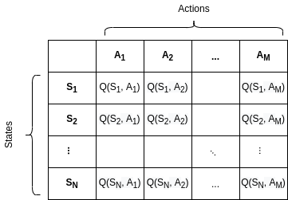
Q-Table
Q-Learning:
The agent will use a Q-table to take the best possible action based on the expected reward for each state in the environment.
In simple words, a Q-table is a data structure of sets of actions and states, and we use the Q-learning algorithm to update the values in the table.
[Source: https://tinyurl.com/3x9vrnfr]
13

Slide 14
Q-Function
Q-Learning:
The Q-function uses the Bellman equation and takes state(s) and action(a) as input. The equation simplifies the state values and state-action value calculation.
$Q^{π}$($s_{t},a_{t}$) = E[$R_{t+1}+γR_{t+2}+γ^{2}R_{t+3}+…|s_{t},a_{t}$]
Q-values for the state given a particular state
Expected discounted cumulative reward
Given the state and action
14

Slide 15
An Introduction to Bellman Equation’s Parameters
Q-Learning:
Alpha(α) = learning rate 0< α <1
γ= Gamma is the discount factor. 0< γ <1
alpha defines the learning rate or step size. As we can see from the equation, the new Q-value for the state is calculated by incrementing the old Q-value by alpha multiplied by the selected action’s Q-value.
In Q-learning, gamma is multiplied by the estimation of the optimal future value. The next reward’s importance is defined by the gamma parameter.
15

Slide 16
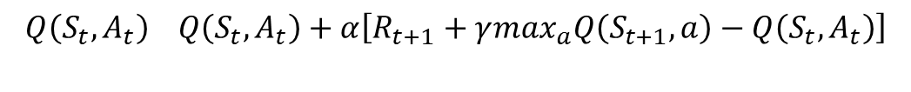
Q-Learning:
Updating Q-values through Bellman equation
We will update the function Q(S_{t}, A_{t}) using the equation. It uses the previous episode’s estimated Q-values, learning rate, and Temporal Differences error.
$$Q\left(S_{t},A_{t}\right) Q\left(S_{t},A_{t}\right)+α\left[R_{t+1}+γ\max_{a}Q\left(S_{t+1},a\right)−Q\left(S_{t},A_{t}\right)\right]$$
New
Q-value estimation
Former
Q-value estimation
Learning
Rate
Immediate
Reward
Discounted Estimate
Optimal Q-value
Of next state
Former
Q-value estimation
TD Target
TD Error
16

Slide 17
A sample of updating Q-table
Q-Learning:
Updating
Q(s,a)=(1-α)Q(s,a)+(α)[R(s,a,s')+γmaxQ(s',a')]
 | A1 | A2 | A3 | A4
S1 | 0 | 0 | 0 | 0
S2 | 0 | 0 | 0 | 0
S3 | 0 | 0 | 0 | 0
 | A1 | A2 | A3 | A4
S1 | 0.4 | 0.8 | 0.2 | 0.1
S2 | 0.7 | 0.3 | 0.6 | 0
S3 | 0.7 | 0.1 | 0.3 | 0.2
17

Slide 18
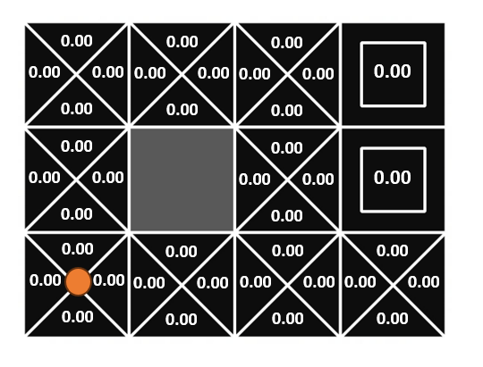
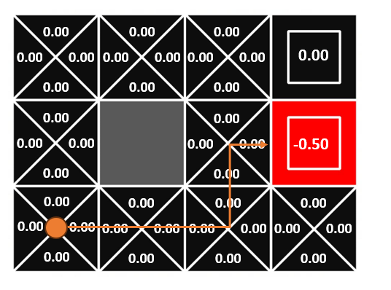
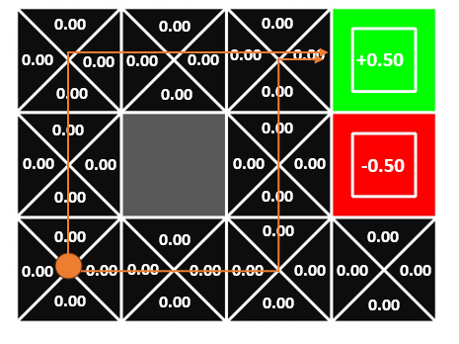
Q-Learning:
Updating Q-values
γ =0.9, α=0.5, R=+1, -1
+1
-1
Q(s,a)=(1-α)Q(s,a)+(α)[R(s,a,s')+γmaxQ(s',a')]
18

Slide 19
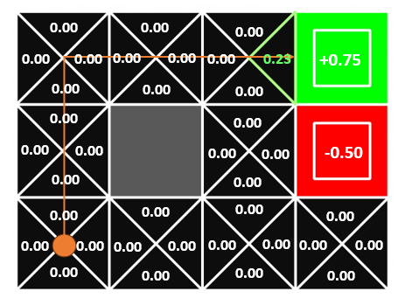
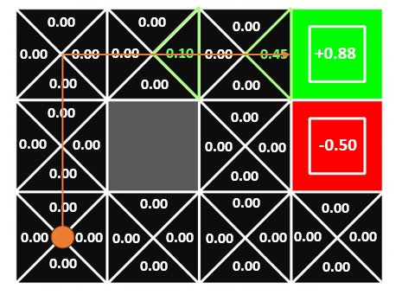
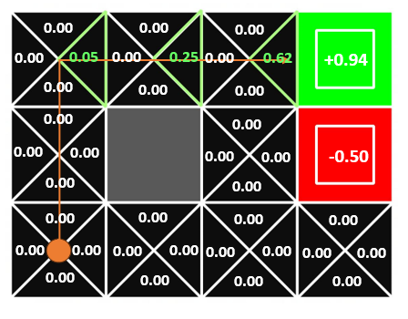
Q-Learning:
Updating Q-values
Q(s,a)=(1-α)Q(s,a)+(α)[R(s,a,s')+γmaxQ(s',a')]
19

Slide 20
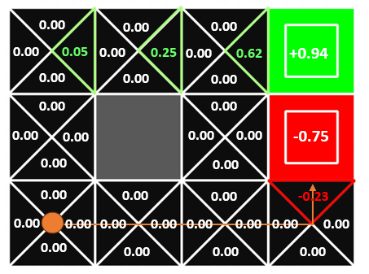
Q-Learning:
Updating Q-values
The agent continue learning to …??
Q(s,a)=(1-α)Q(s,a)+(α)[R(s,a,s')+γmaxQ(s',a')]
20

Slide 21
Exploration vs. Exploitation
Start
Epsilon is related to the epsilon-greedy action selection procedure in the Q-learning algorithm.
In epsilon-greedy action selection, the agent uses exploitations to take advantage of prior knowledge and exploration to look for new options.
Ɛ
1-Ɛ
Exploration
Exploitation
Select
Random Action
Select best
Known Action
21

Slide 22
Sample code
Using python and with assuming the below parameters, we wrote a code for updating Q-table.
Parameters
alpha = 0.1, gamma = 0.6, epsilon = 0.1,
num_episodes=10000, max_steps_per_episode=100
https://colab.research.google.com/drive/1OfwQQqhmK8aSaM0AS6xc1OFIfbl46W42?usp=sharing
22

Slide 23
Sample code
import numpy as np
import random
# Parameters
alpha = 0.1 # Learning rate
gamma = 0.6 # Discount factor
epsilon = 0.1 # Exploration rate
num_episodes = 10000 # Number of episodes to train on
max_steps_per_episode = 100 # Limit the number of steps per episode
# Environment setup
num_states = 10
num_actions = 3
Q = np.zeros((num_states, num_actions)) # Q-table initially filled with zeros
23

Slide 24
Sample code
# Dummy environment response (to be replaced with a real environment)
def step(state, action):
# This function should be replaced with the actual dynamics of the environment
# For the sake of example, we assume every action leads to a new state
# randomly and gives a random reward.
if num_states == 9:
return random.randint(0, num_states - 1), reward==+1
elif num_states==8:
return random.randint(0, num_states - 1), reward==-1
else:
return random.randint(0, num_states - 1), random.uniform(-1, 1)
24

Slide 25
Sample code
# Training loop
for episode in range(num_episodes):
state = random.randint(0, num_states - 1) # Start at a random state
for _ in range(max_steps_per_episode): # Changed 'step' to '_' to avoid conflict
# Exploration-exploitation trade-off
if random.uniform(0, 1) < epsilon:
action = random.randint(0, num_actions - 1) # Explore action space
else:
action = np.argmax(Q[state]) # Exploit learned values
# Take action and observe the outcome state and reward
new_state, reward = step(state, action) # 'step' here is the function defined earlier
25

Slide 26
Sample code
# Q-learning algorithm
Q[state, action] = Q[state, action] + alpha * (reward + gamma * np.max(Q[new_state]) - Q[state, action])
# Transition to the next state
state = new_state
# Display the learned Q-table
print("Q-table:")
print(Q)
Q-table:
[[-0.02776233 -0.01735738 0.04502264] [ 0.08347004 -0.13304128 0.15789628] [-0.02942451 -0.13063879 0.13146398] [-0.00323057 0.0427315 -0.0603509 ]
[ 0.12286208 -0.08334864 -0.03393845] [-0.06184578 -0.29502079 0.13205288]
[ 0.22461559 -0.03299951 -0.08343481] [-0.14660276 -0.00654734 0.09716222] [-0.13534533 -0.02063201 0.15570354] [-0.08623073 0.11169402 -0.08088196]]
26

Slide 27
Applications
Adaptive traffic signal control based on delay minimization strategy
Playing the 2600 Atari game using Deep Q-learning
Human-level control through deep Q-learning
Hybrid Control for Robot Navigation
Multi-agent cooperation for Robot Soccer
27

Slide 28
Summary
Q-Learning is one of the common methods available in Reinforcement Learning.
Trial-and-error method is used for the exploratory agent to explore in a complex and nondeterministic environment, and then execute (exploitation) the best action based on experience.
The experience is based on the reward or penalty that received from the previous trial-and-error action.
Reinforcement learning algorithm promised to improve the performance of an agent with the agent’s experience.
28

Slide 29
References
[1]. W. by: baeldung, “Epsilon-Greedy Q-Learning,” Baeldung on Computer Science, https://www.baeldung.com/cs/epsilon-greedy-q-learning (accessed Nov. 15, 2023)
[2]. B. Jang, M. Kim, G. Harerimana, and J. W. Kim, “Q-Learning Algorithms: A comprehensive classification and applications,” IEEE Access, vol. 7, pp. 133653–133667, 2019. doi:10.1109/access.2019.29412299
[3]. A. A. Awan, “An introduction to Q-learning: A tutorial for Beginners,” DataCamp, https://www.datacamp.com/tutorial/introduction-q-learning-beginner-tutorial (accessed Nov. 15, 2023).
[4]. S. Bhatt, “Reinforcement learning 101,” Medium, https://towardsdatascience.com/reinforcement-learning-101-e24b50e1d292 (accessed Nov. 15, 2023)
[5]. freeCodeCamp.org, “An introduction to Q-learning: Reinforcement learning,” freeCodeCamp.org, https://www.freecodecamp.org/news/an-introduction-to-q-learning-reinforcement-learning-14ac0b4493cc/ (accessed Nov. 15, 2023).
[6]. Y. K. Chin, L. K. Lee, N. Bolong, S. S. Yang, and K. T. Teo, “Exploring Q-learning optimization in Traffic Signal Timing Plan Management,” 2011 Third International Conference on Computational Intelligence, Communication Systems and Networks, 2011. doi:10.1109/cicsyn.2011.64
[7]. L. Canese et al., “Multi-agent Reinforcement Learning: A review of challenges and applications,” Applied Sciences, vol. 11, no. 11, p. 4948, 2021. doi:10.3390/app11114948
29

Slide 30
???
30

